Slide 1

Computing Research Project for including Digitalization in Remote working System
Module Project
Module : Computing Research Project
Course : Computing Research Project by doing digitalization for Remote Workers in Business .
Start Date : 13 February 2023
End Date : 23 March 2023
Submission Date : 23 March 2021
Learner Name : Wildan Luqmanul Hakim
Enrollment ID : STTB
Presentation Date : 25 March 2023

Slide 2

Document History
Version Number | Effective Date of release | Summary of Included Changes | Author
1 | March 2023 | First Edition | Wildan Luqmanul Hakim

Slide 3
Project Definition
Project Background:
Jumpstart, a retail chain with 750 stores across the country, has built its reputation on the quality and innovation of its products. However, the company has been impacted by the shift to remote work due to the Covid-19 pandemic, which has disrupted its core business operations in various ways. In response, Jumpstart is seeking to transform its business model to focus more on customer commerce. The Chief Operating Manager has engaged Aceadora Tech to help find a solution to these challenges.
Project Goal:
Inventory tracking and monitoring
Supplier management
Sales and purchase order management
Reporting and analytics
User training and support
Data migration from the old system to the new system

Slide 4
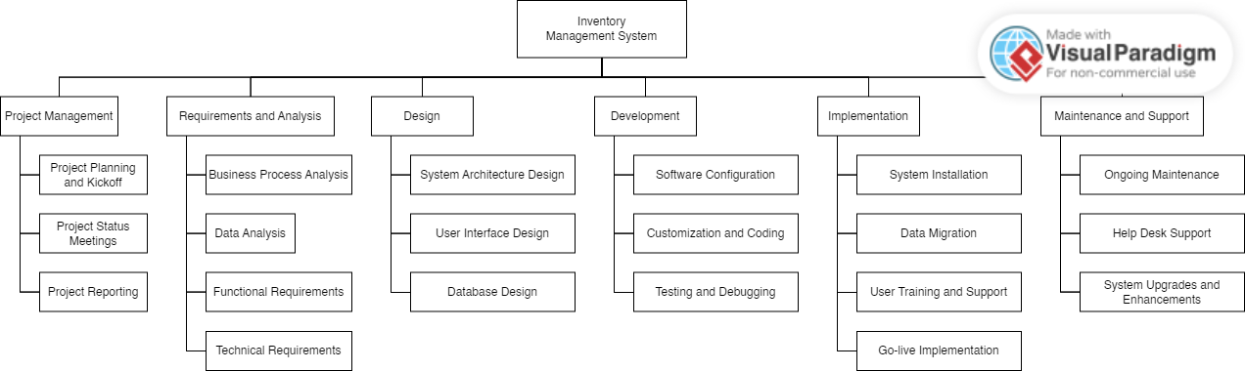
Project Deliverables
Project Deliverables:
Milestone | Target Date | Deliverable
1 | 19 February 2023 | Finalize inventory management software requirements
2 | 20 February 2023 | Select inventory management software vendor
3 | 23 February 2023 | Software installation and configuration
4 | 24 February 2023 | Data migration from old system to new system
5 | 25 February 2023 | User training and support
6 | 28 February 2023 | Go-live implementation

Slide 5
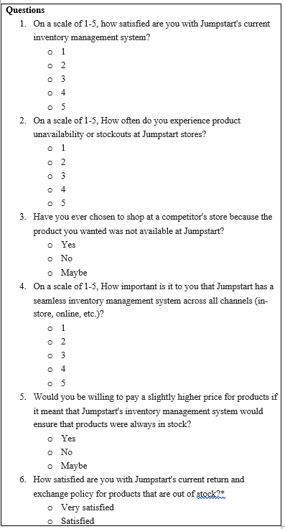
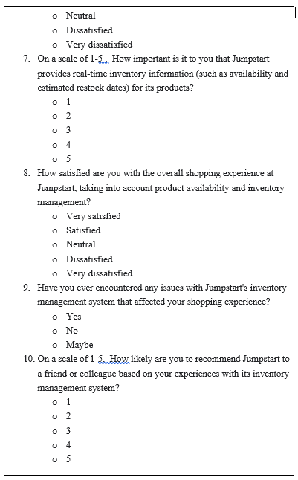
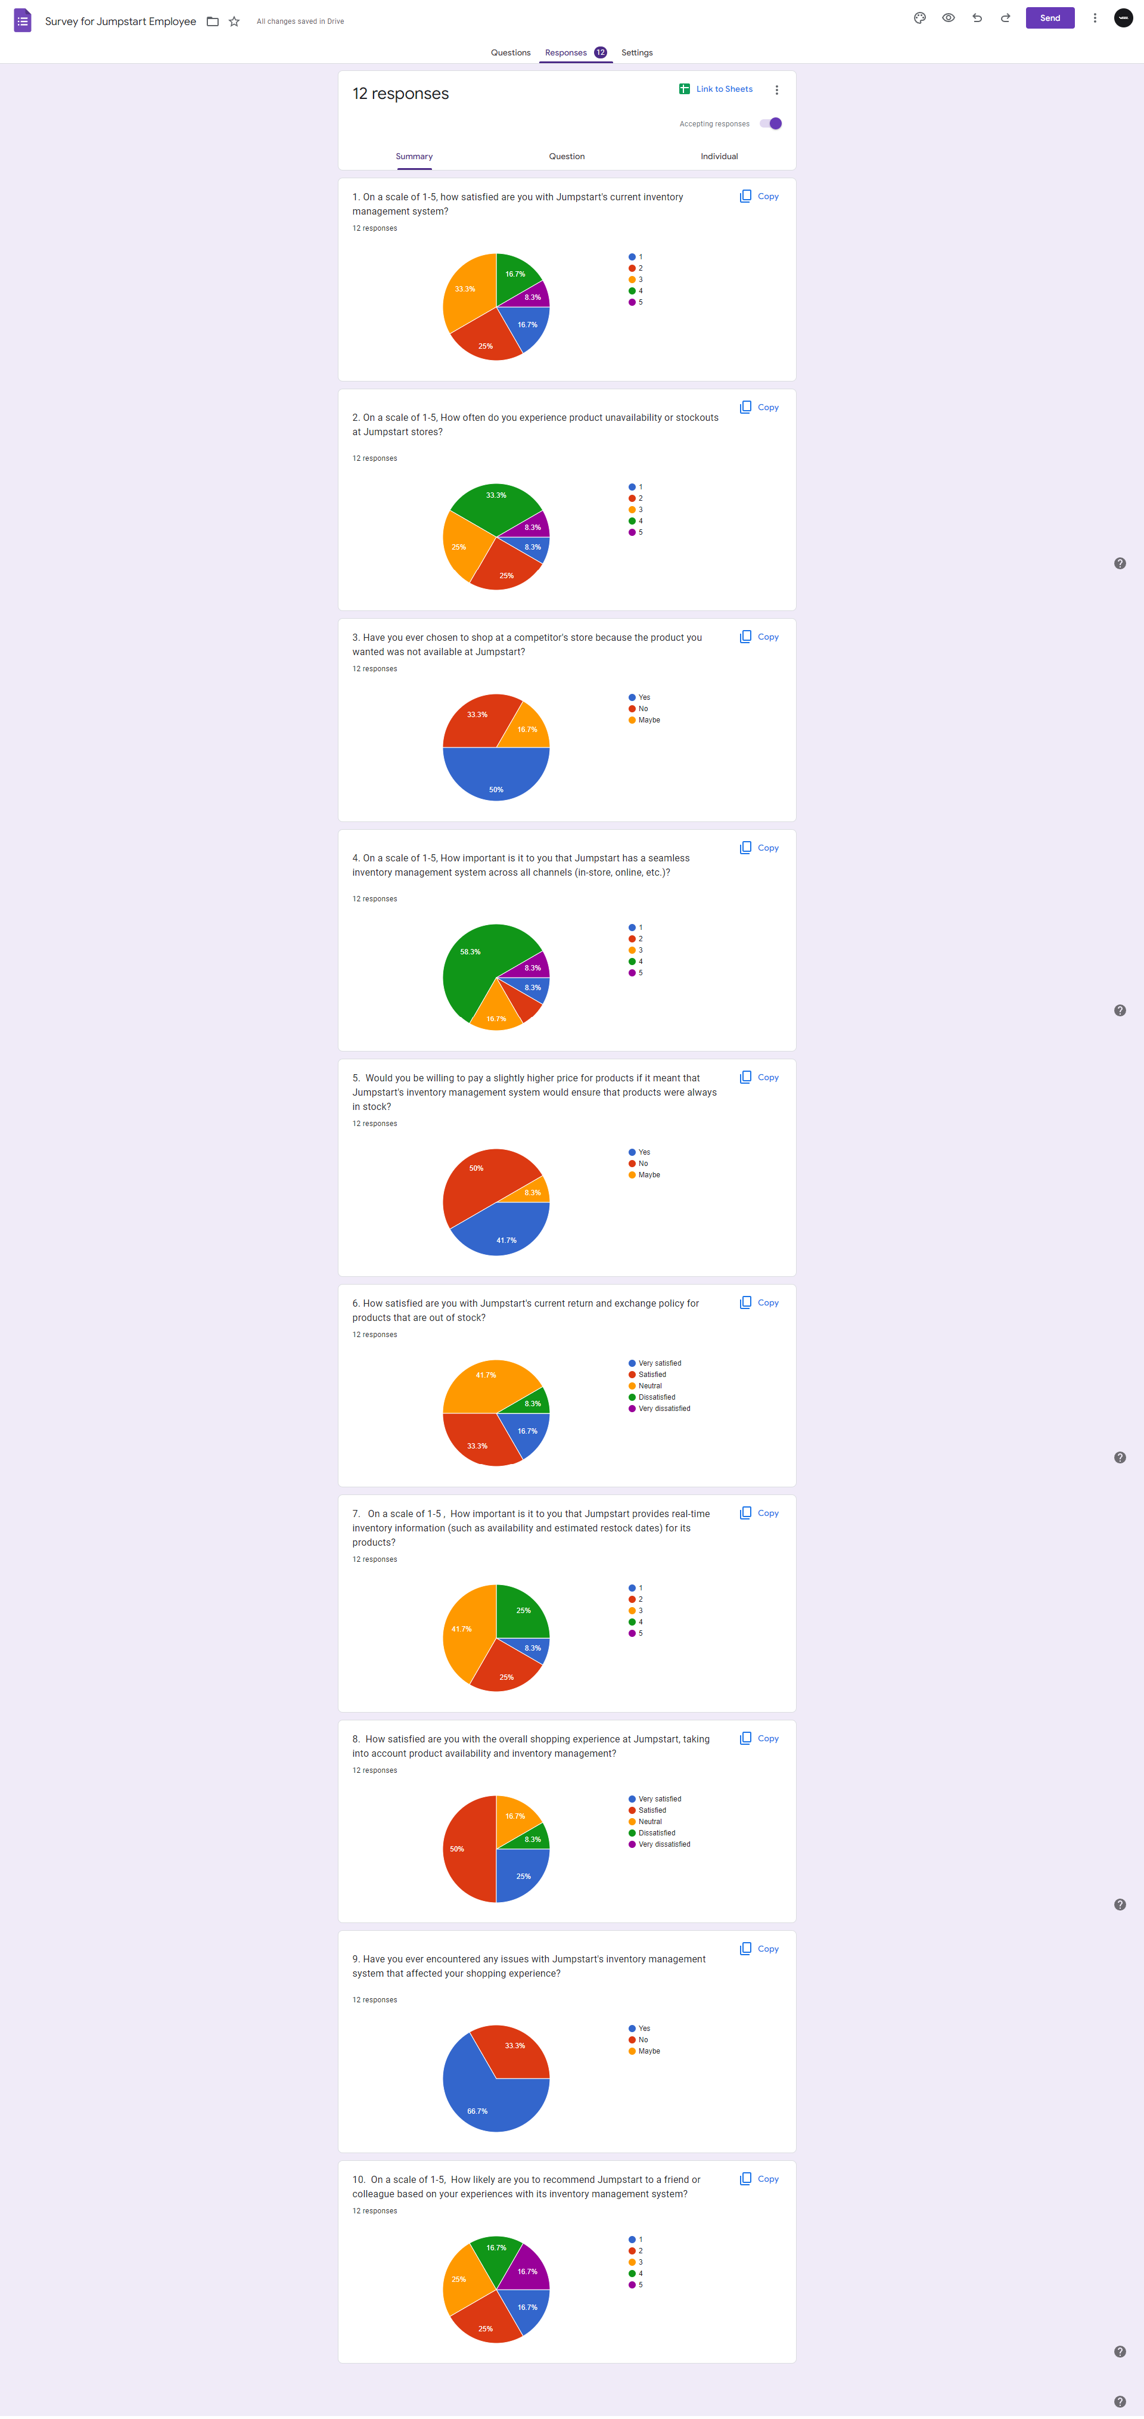
Project Deliverables
Results:
Survey:

Slide 6
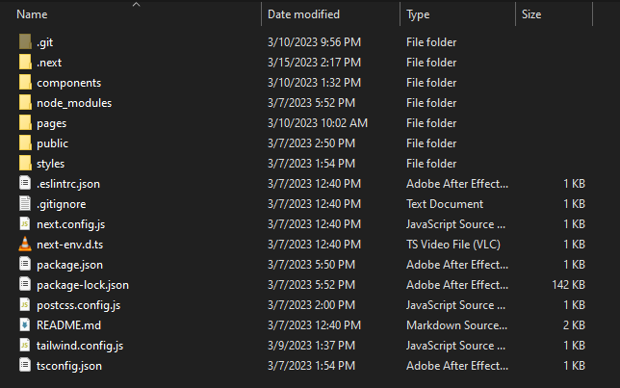
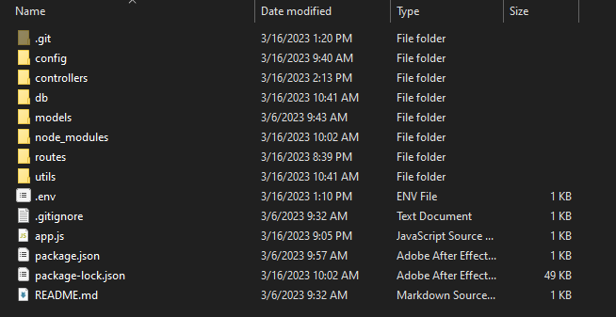
Project Deliverables
List of Evidences
Front-End
Back-End

Slide 7
Project Milestones & Tasks
Project Task ID | Project Task Description | Project Milestone ID
1 | Conduct Survey For information Gathering | 1
2 | Prepare Research Proposal template | 1
3 | Prepare Work Breakdown Structure | 2
4 | Create Gantt Chart using Project Libre | 2
5 | Compare and Evaluate Project Solution by doing Research | 3
6 | Conduct Survey for Jumpstart Opinion on Recommended Solution | 3

Slide 8












Project Environment
Technical Environment and Tools Used
Tailwind CSS
Visual Studio Code
Microsoft Word
JavaScript
GitHub
Microsoft PowerPoint
Express JS
Figma
Google Chrome
MongoDB
Draw.io
Postman API
List of references
https://tailwindcss.com/
https://code.visualstudio.com/
https://www.postman.com/
https://nodejs.org/
https://github.com/
https://www.happyhues.co/
https://expressjs.com/
https://www.figma.com/
https://www.manypixels.co/
https://www.mongodb.com/
https://app.diagrams.net/
https://www.npmjs.com/

Slide 9
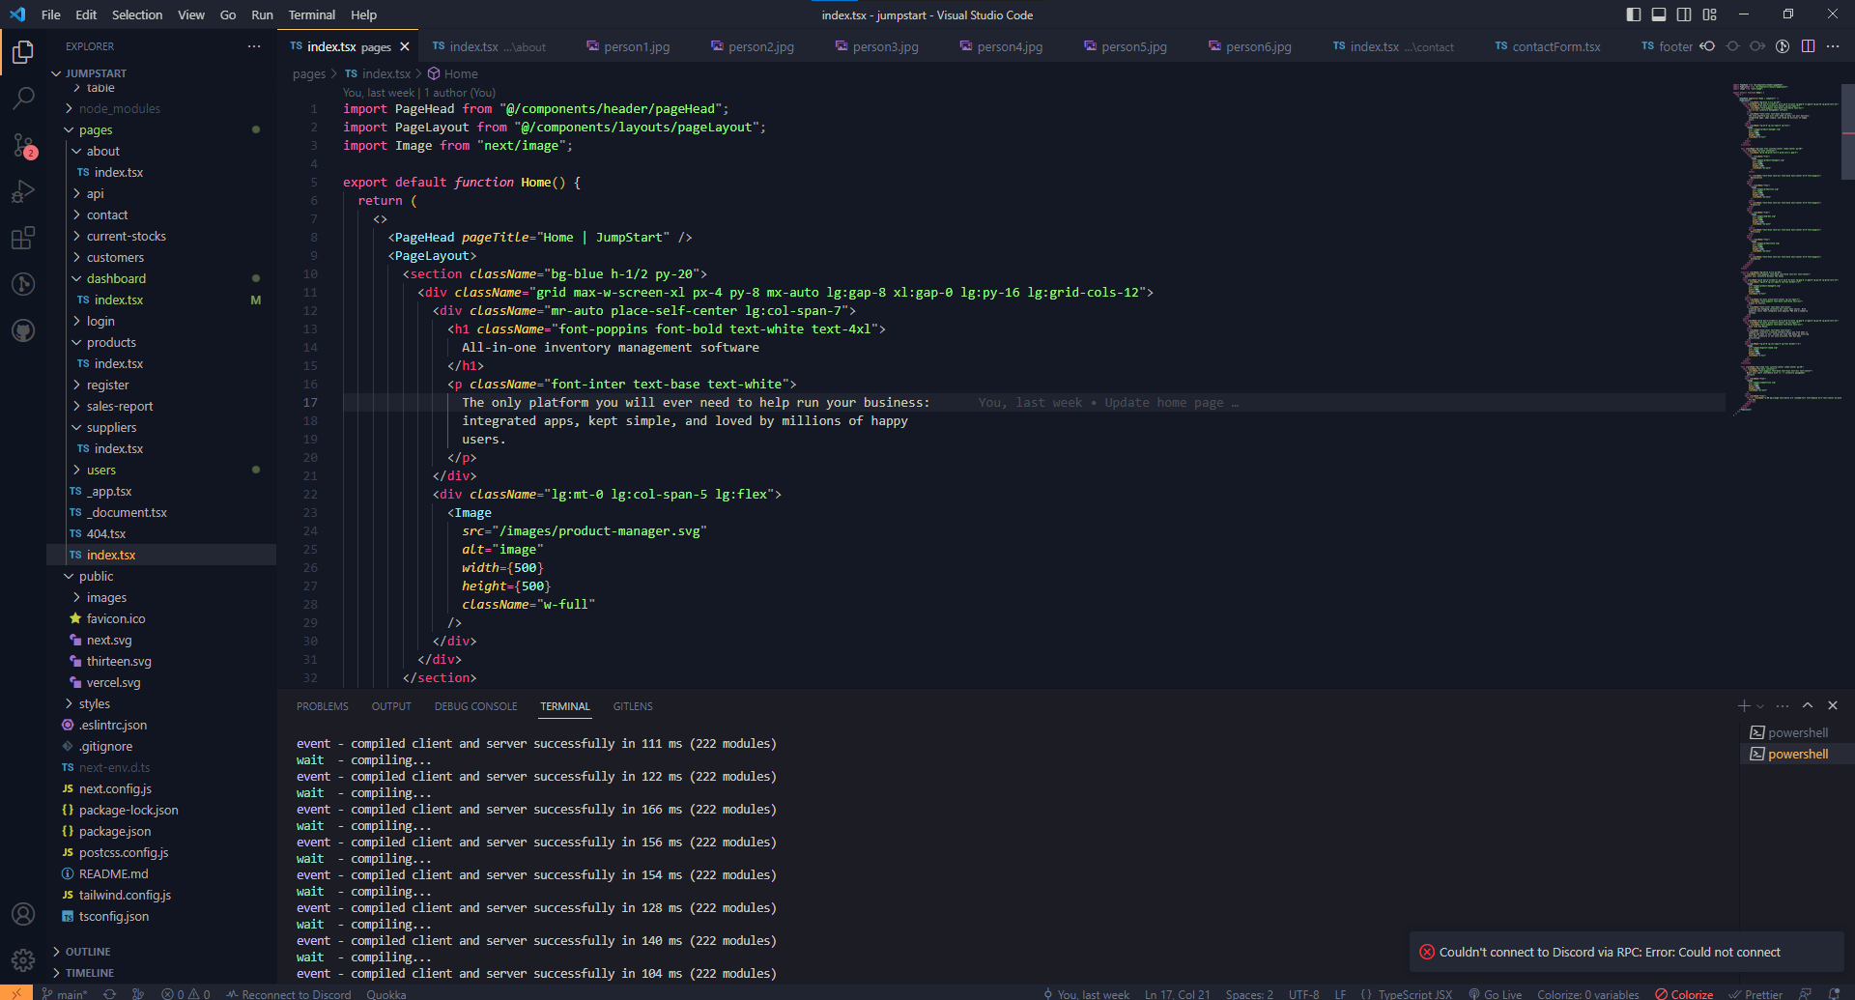
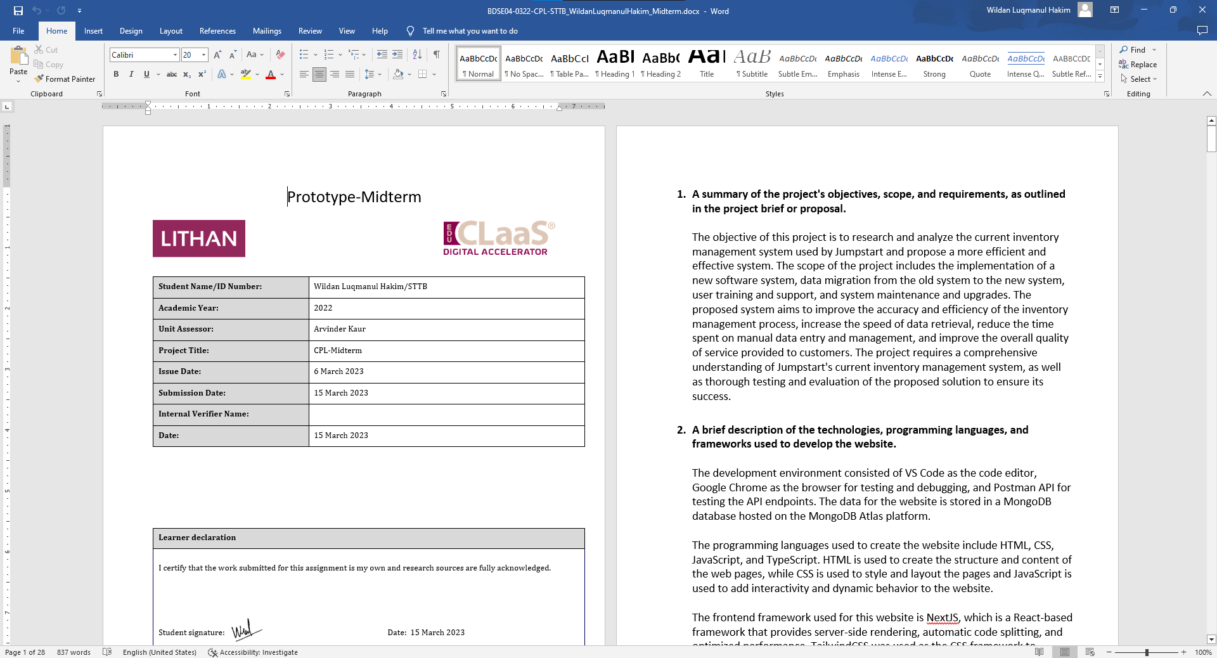
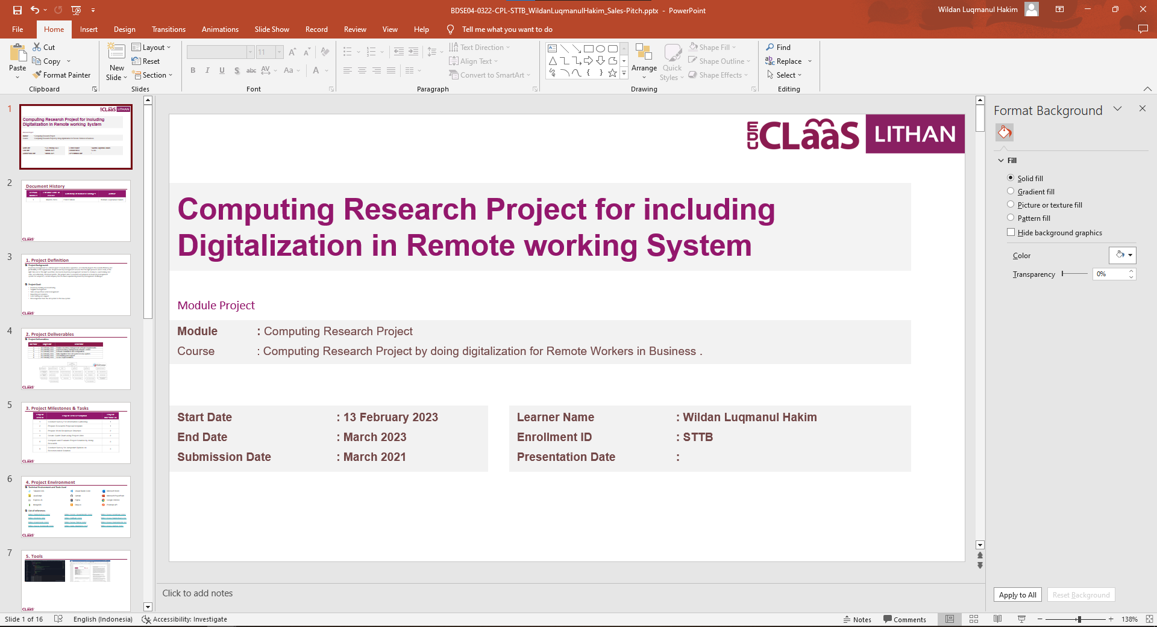
Tools

Slide 10
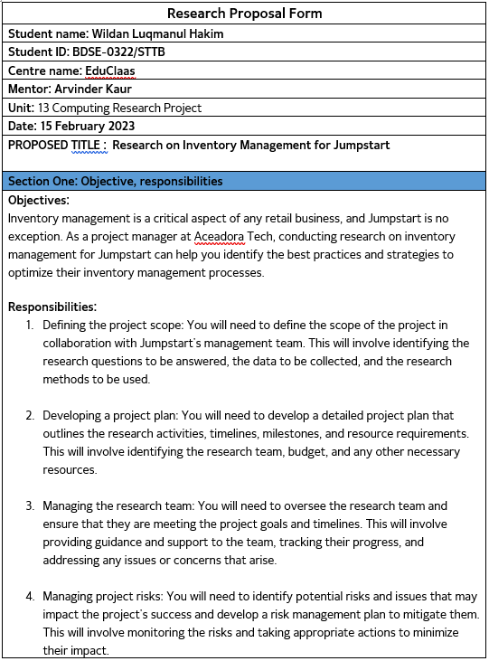
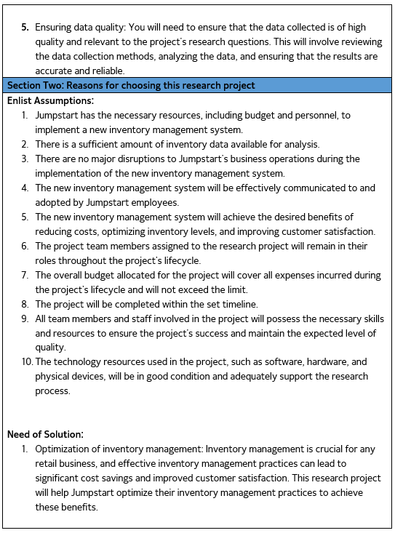
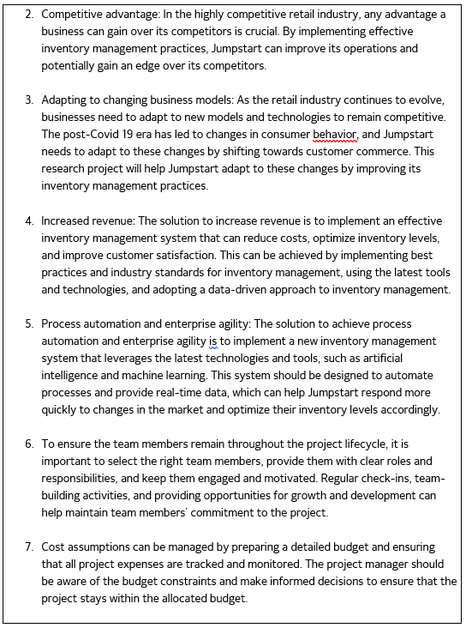
Research Proposal Template

Slide 11
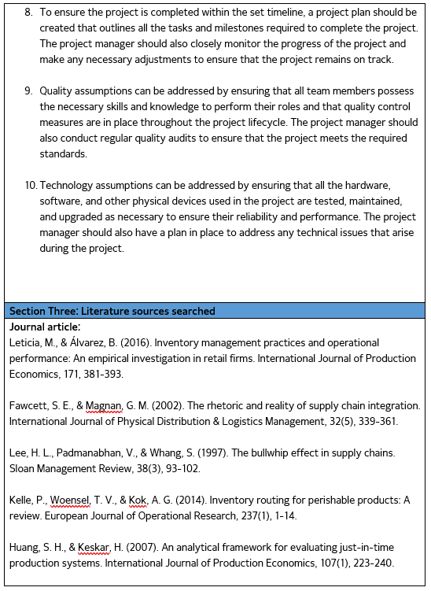
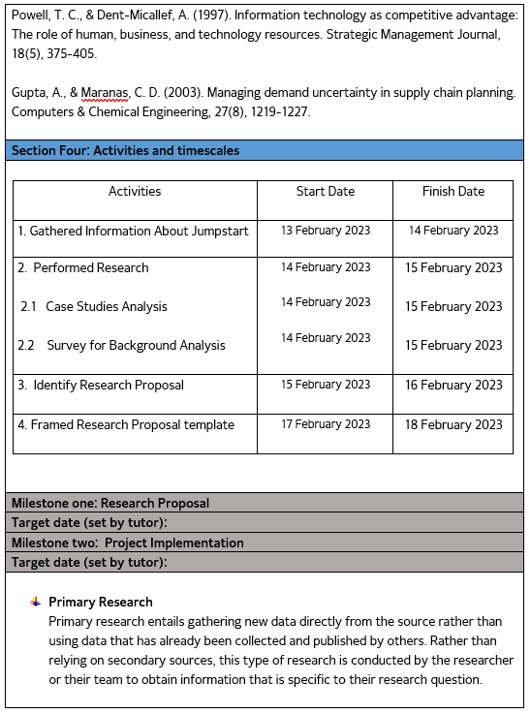
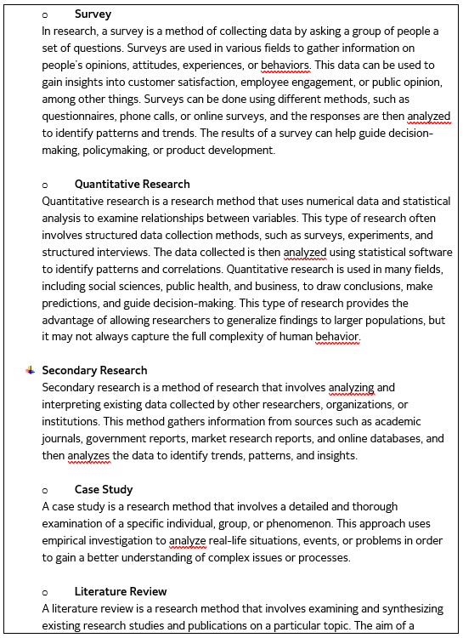
Research Proposal Template

Slide 12
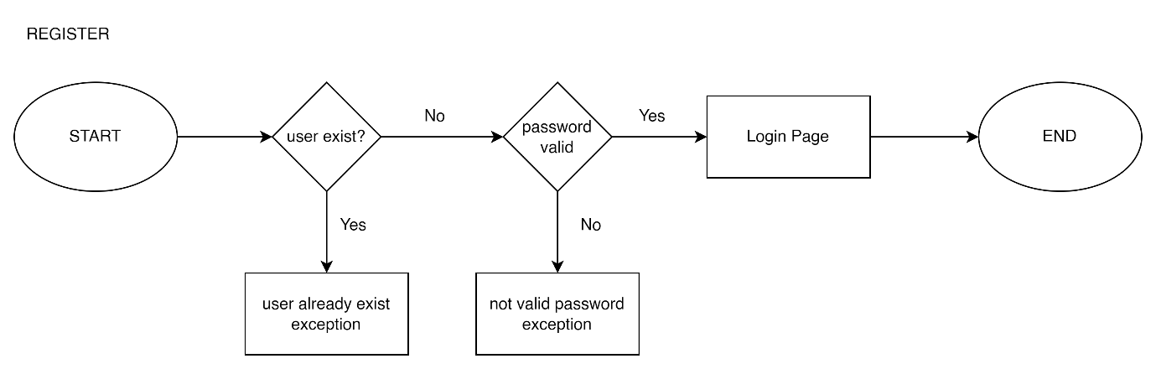

Project Design
Flowchart

Slide 13
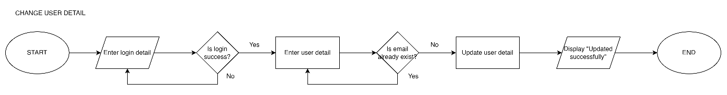
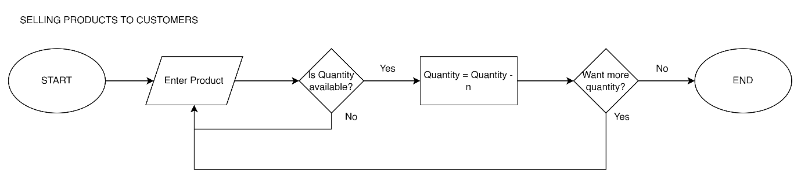
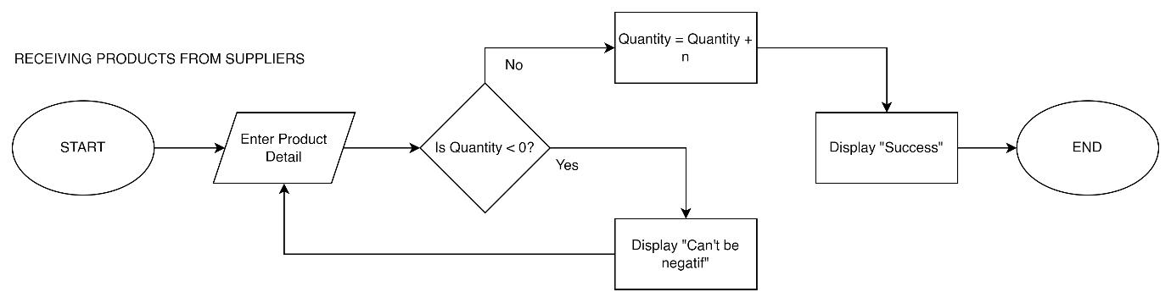
Project Design
Flowchart

Slide 14


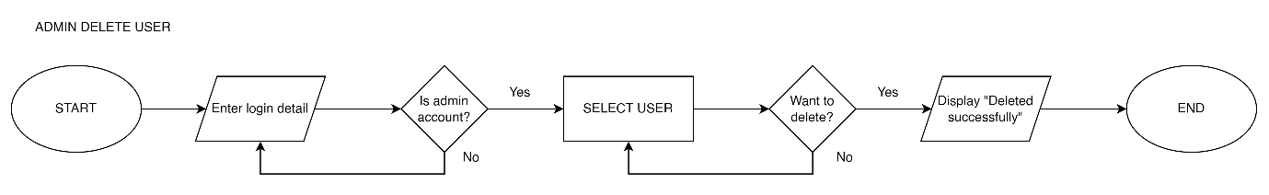
Project Design
Flowchart Admin

Slide 15
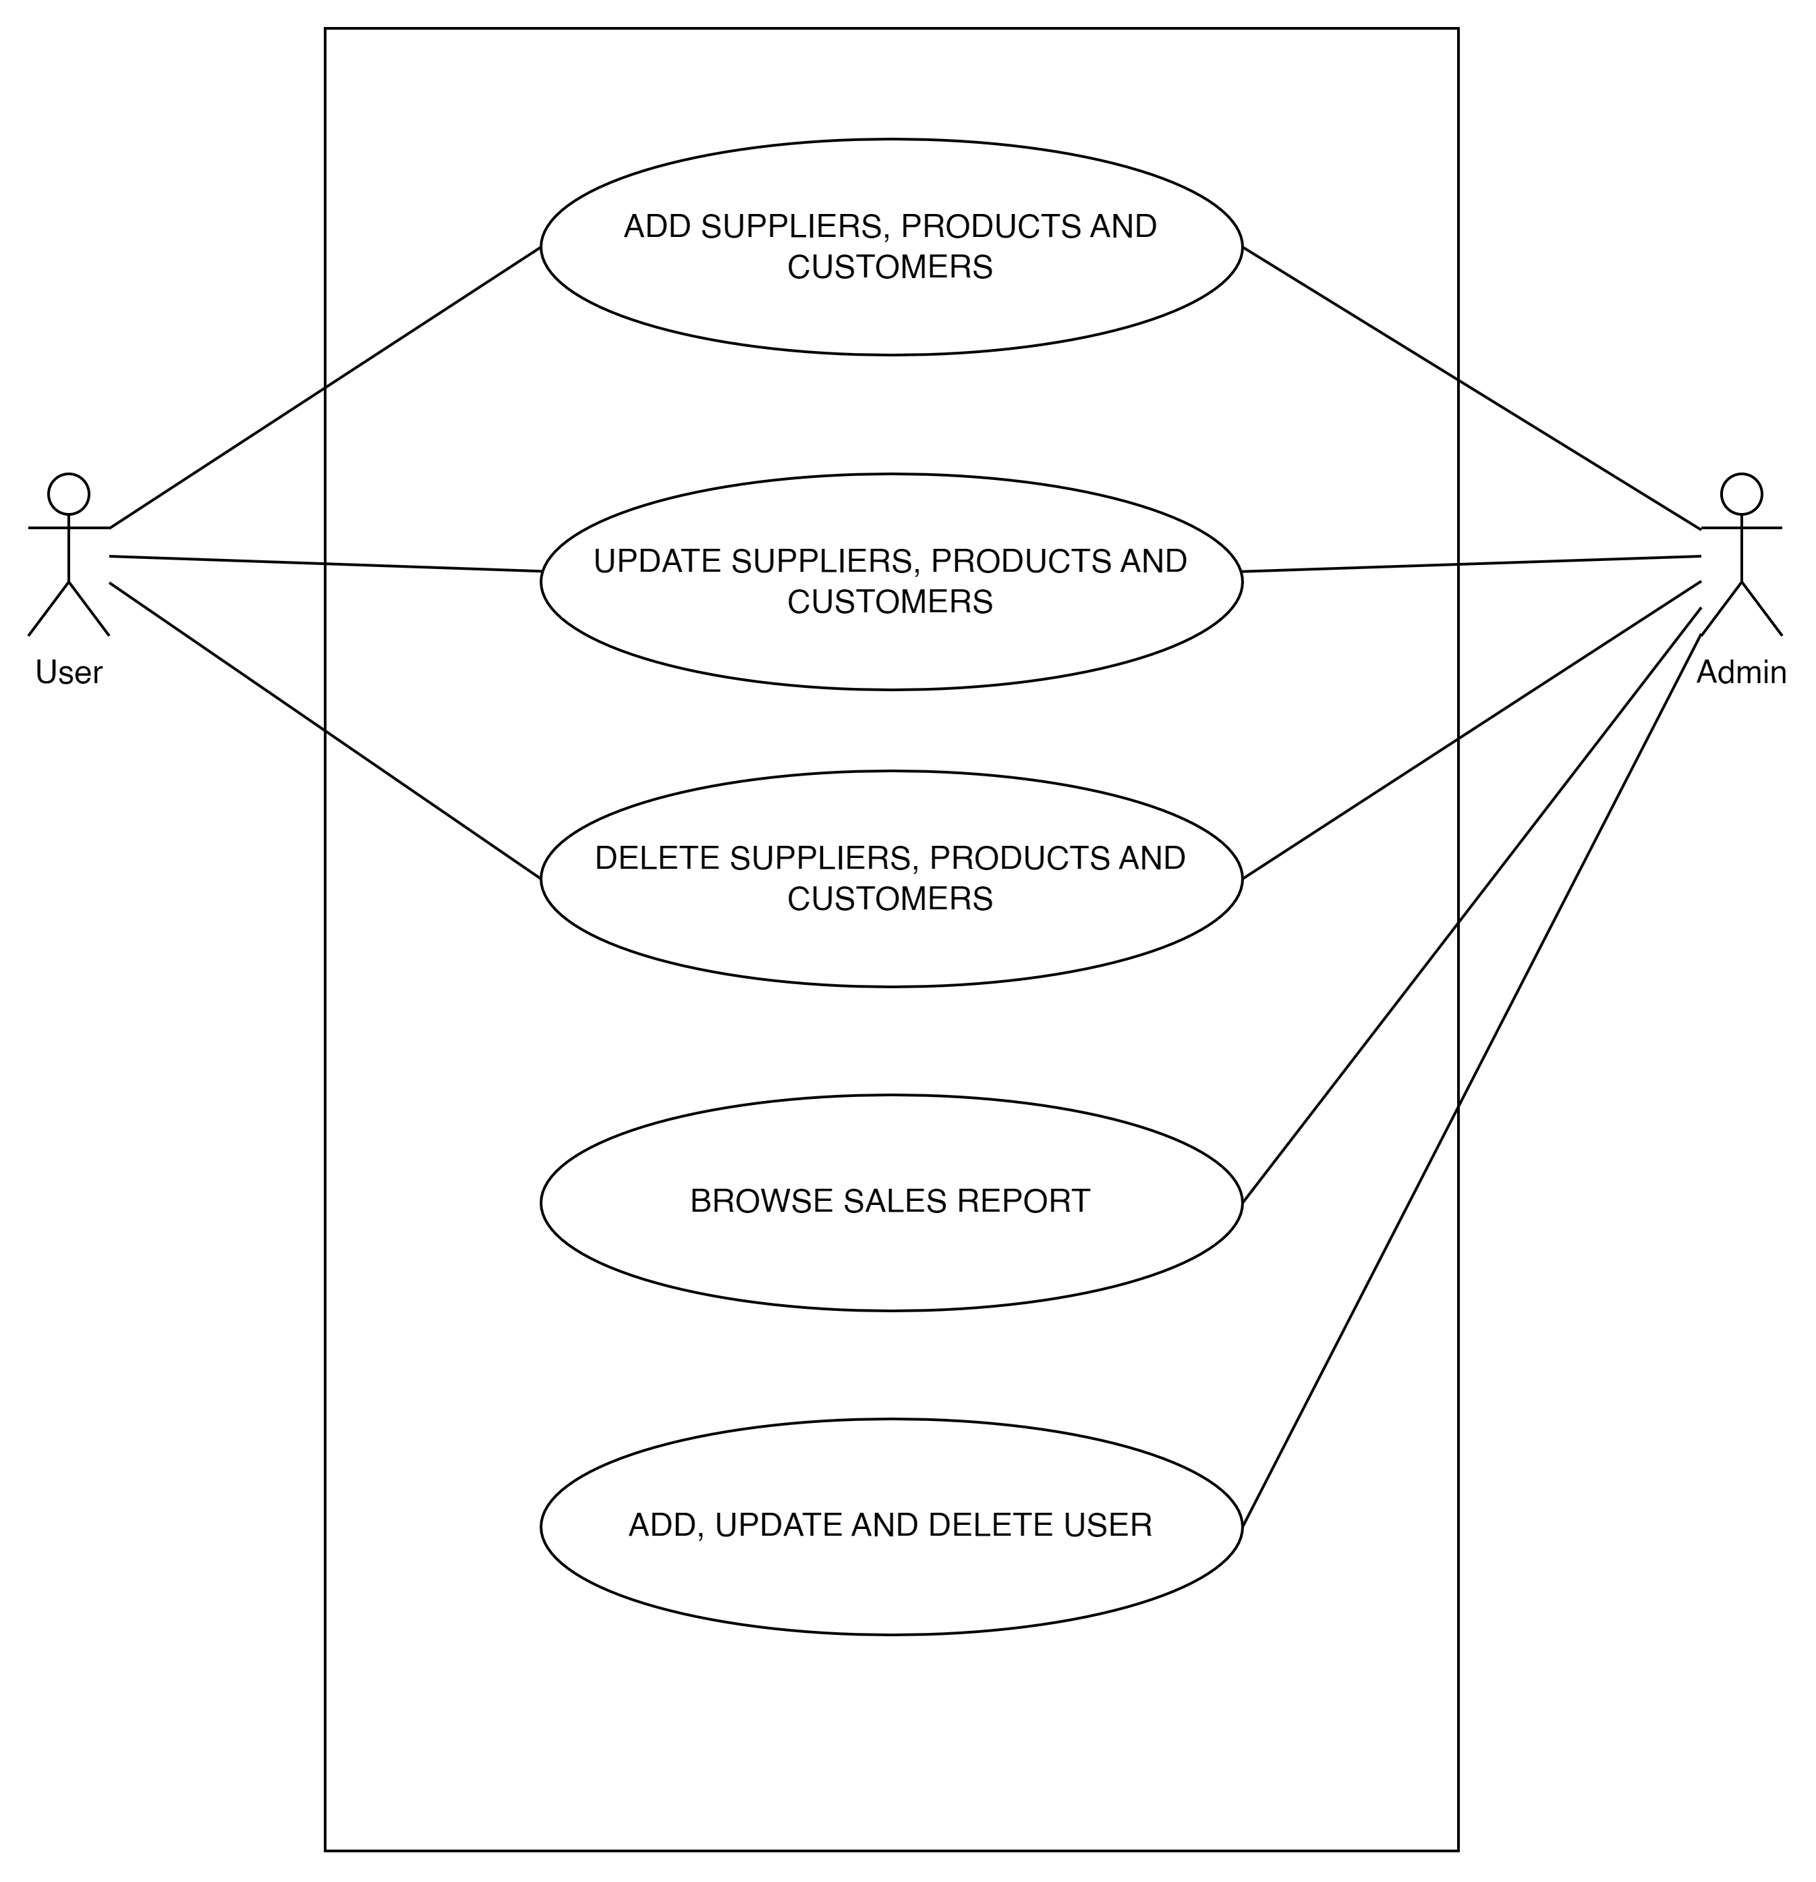
Project Design
Use Case

Slide 16
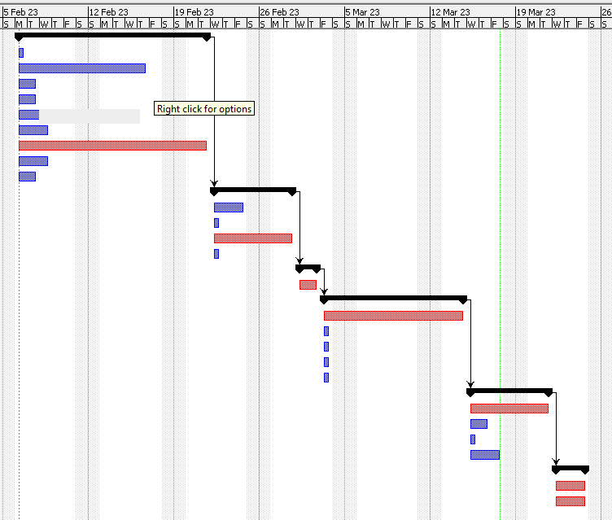
Project Gantt Chart

Slide 17
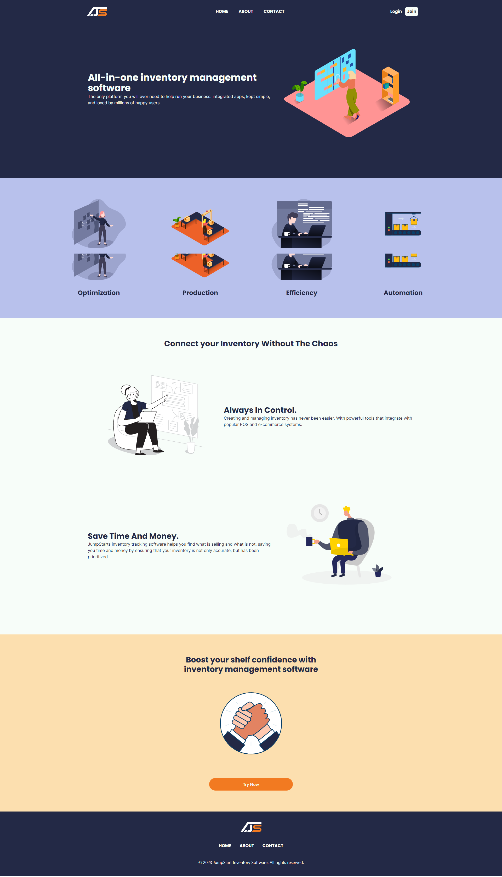
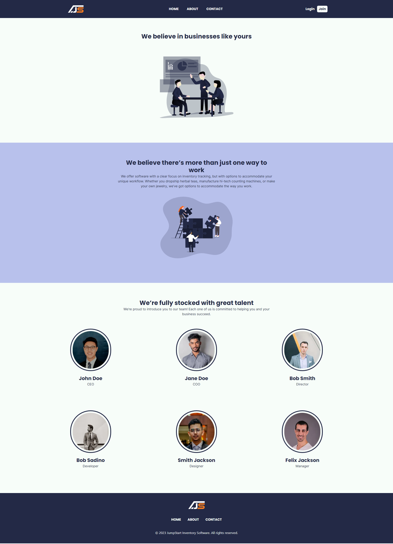
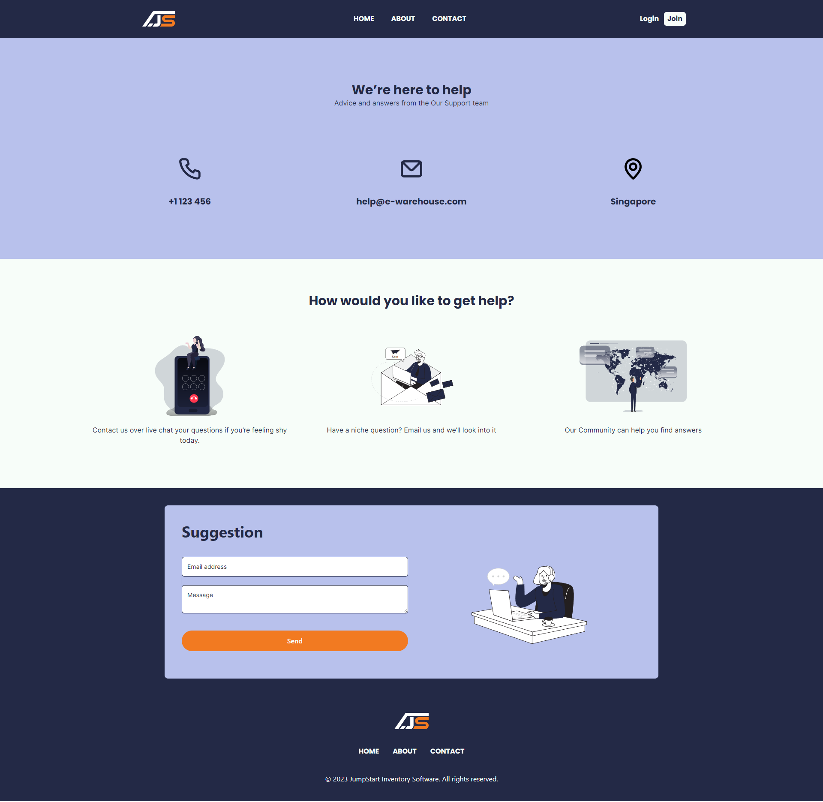
Project Execution

Slide 18
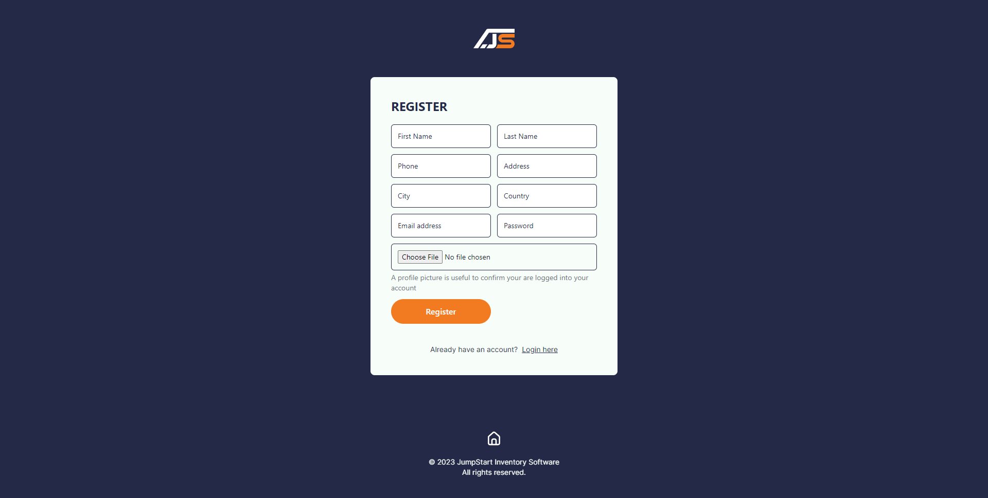
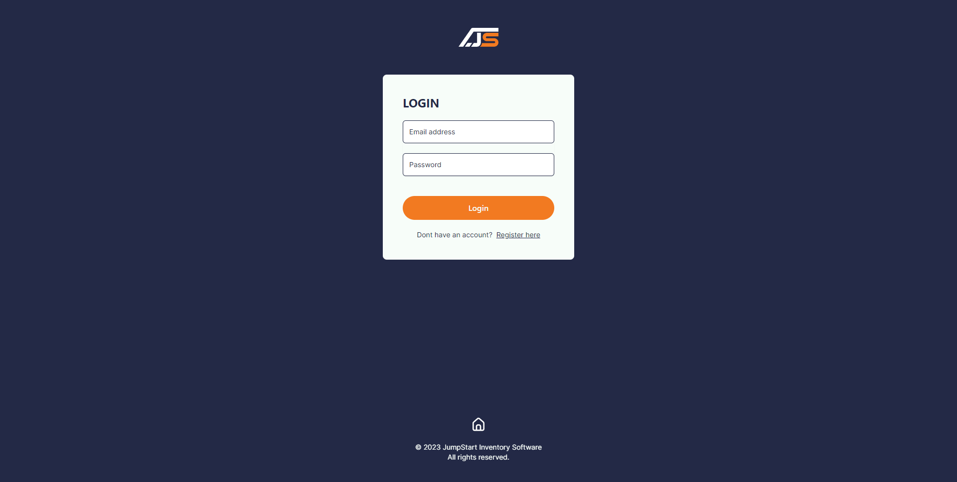
Project Execution

Slide 19
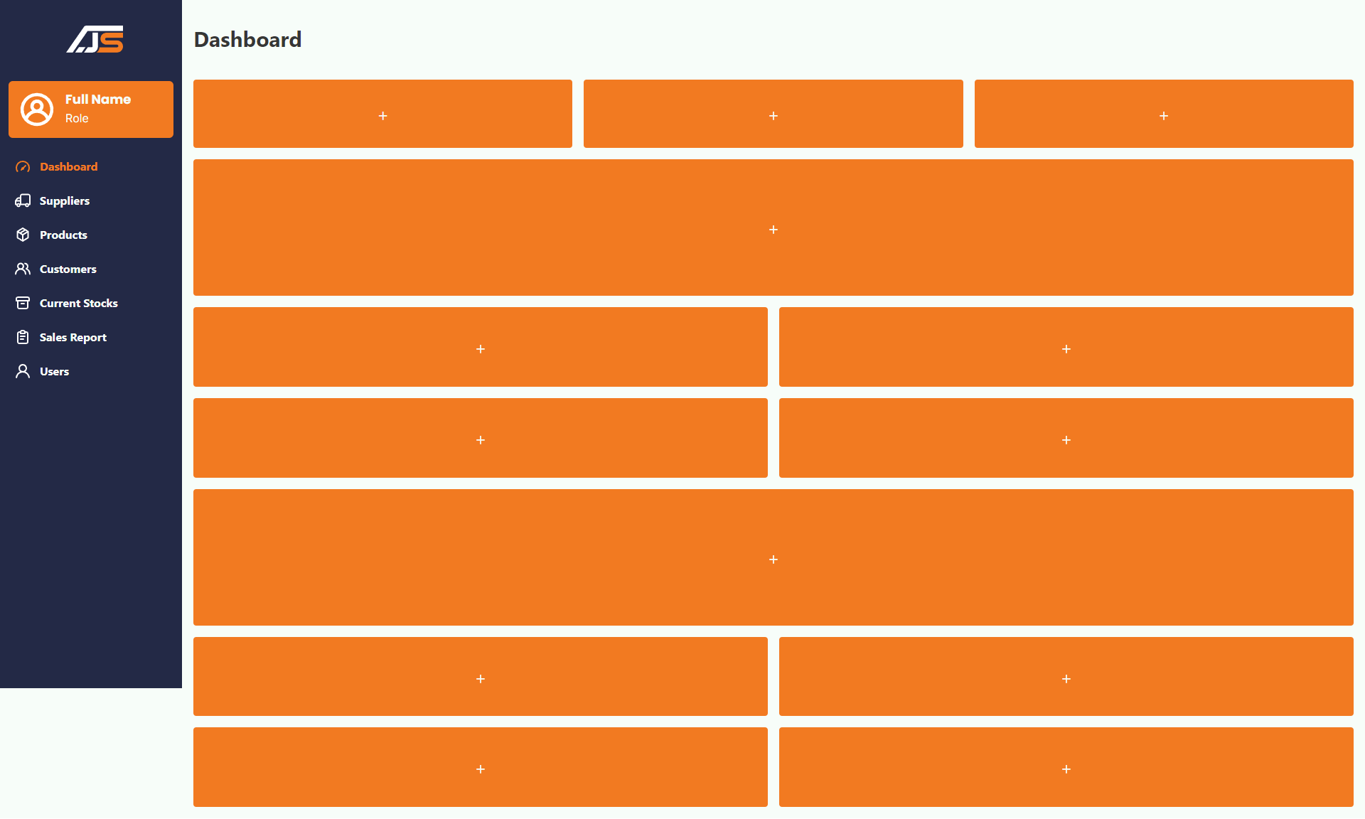
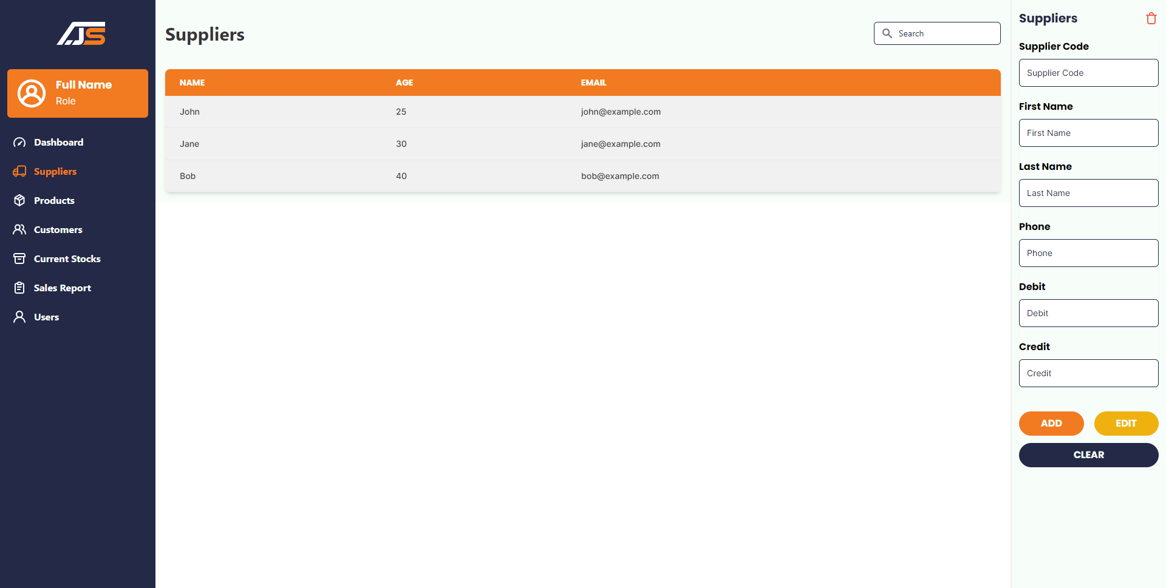
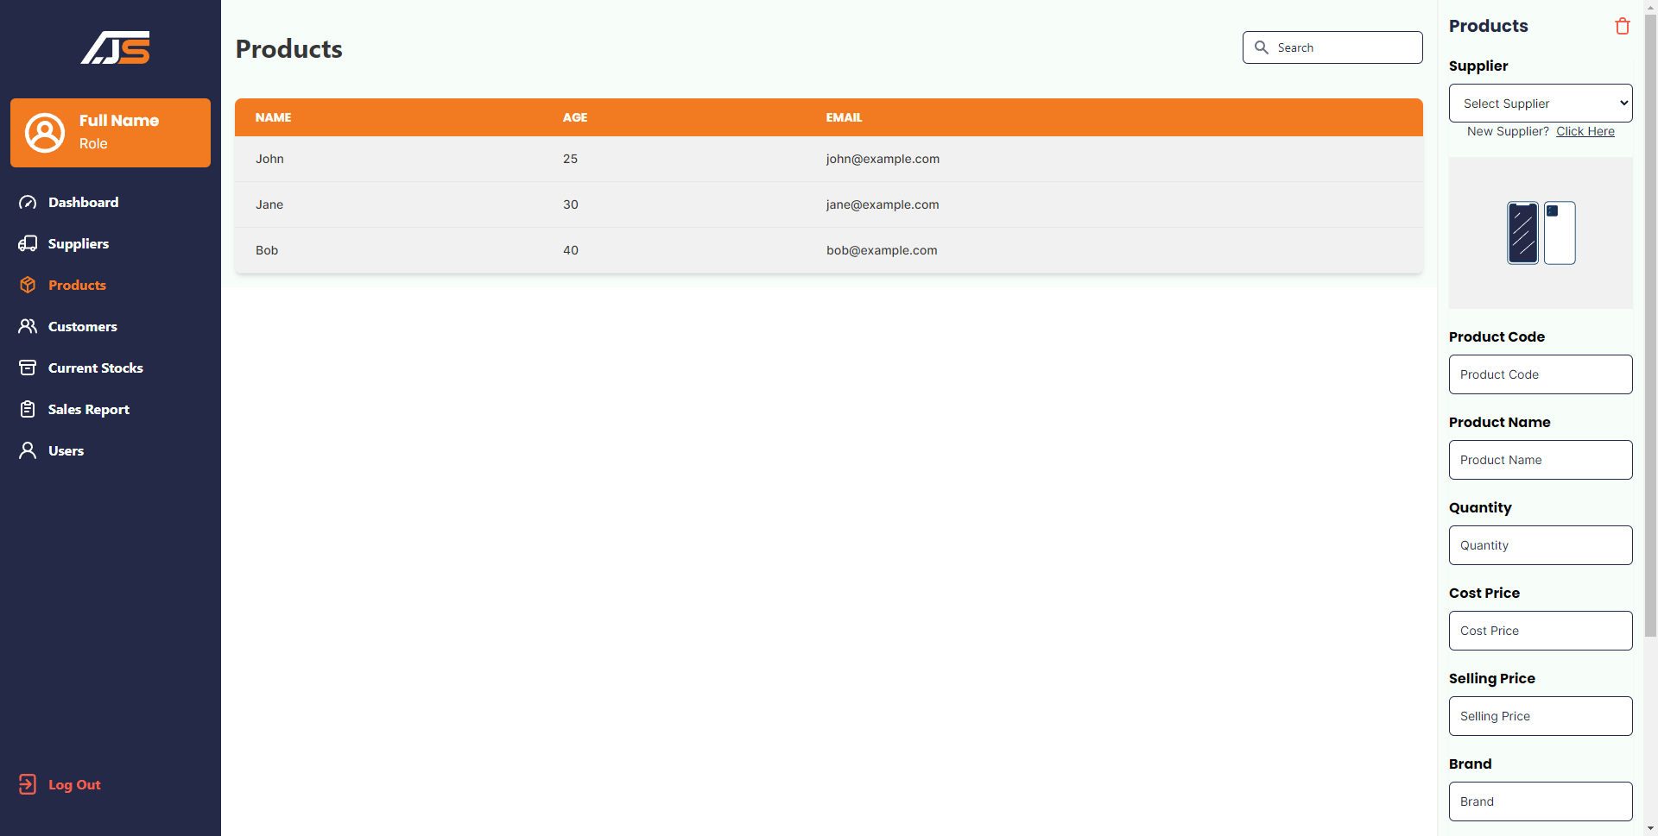
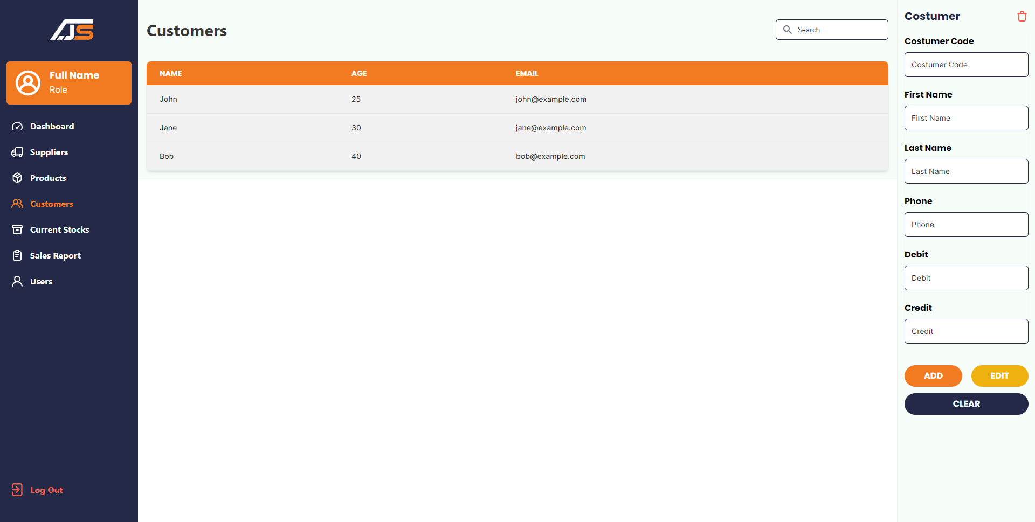

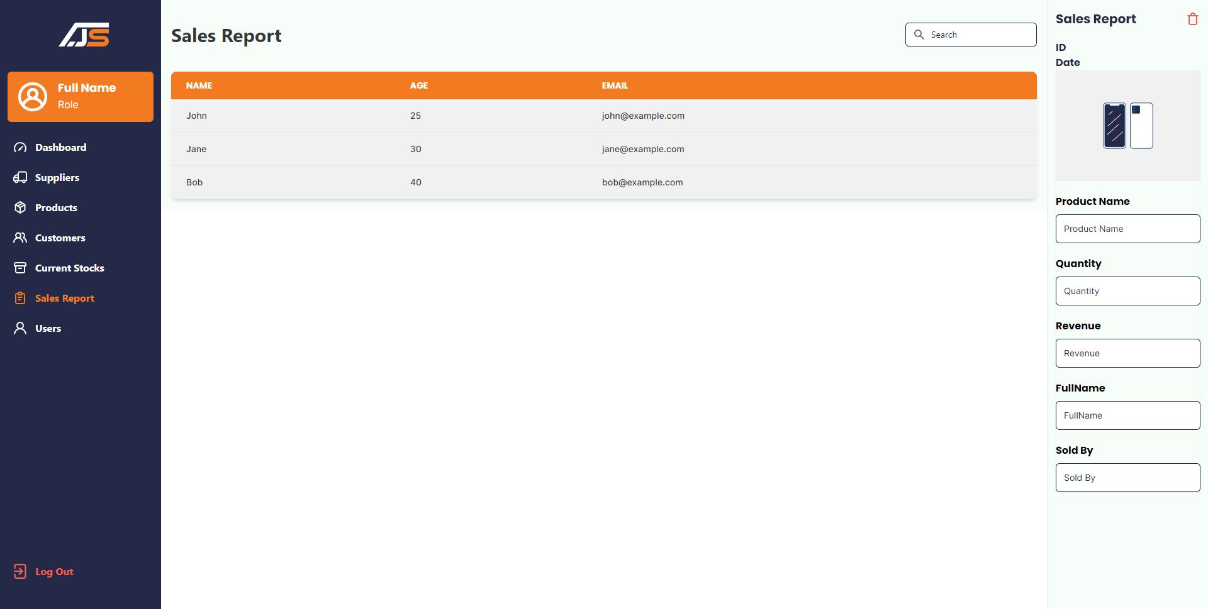
Project Execution

Slide 20
Milestone Feedback & Action Taken
Project Milestone ID | Milestone Feedback received from Tutor / Learning Facilitator | Action Taken (Yes / No)
1 | Update Project background | Yes
 | Add use case | Yes
2
3

Slide 21
Proposed Improvements
Tracking Deliver from Supplier to Costumer
Add Category for Products

Slide 22
Thank You

